Slide 1
Foundations of Large Language Models: Tools, Techniques, and Applications
Notes:
Note for instructor: please ensure you check the accessibility of your own slides before you deliver your presentation: https://uwaterloo.ca/centre-for-teaching-excellence/accessibility-checklist-ms-powerpoint

Slide 2

Foundations of Large Language Models: Tools, Techniques, and Applications
(3rd edition)
Instructor: Brian Zimmerman
(based on slides from Rodrigo Nogueira)
Photo source: Bing Image Creator

Slide 3
Overview of Today – Module 4
Recap of Module 3
LLMs in Information Retrieval
Processing Long Documents
Tokens and Token Embeddings
Decoding Algorithms
Evaluating Generative Language Models
Computational Overhead of LLMs
LLMs Going Forward

Slide 4
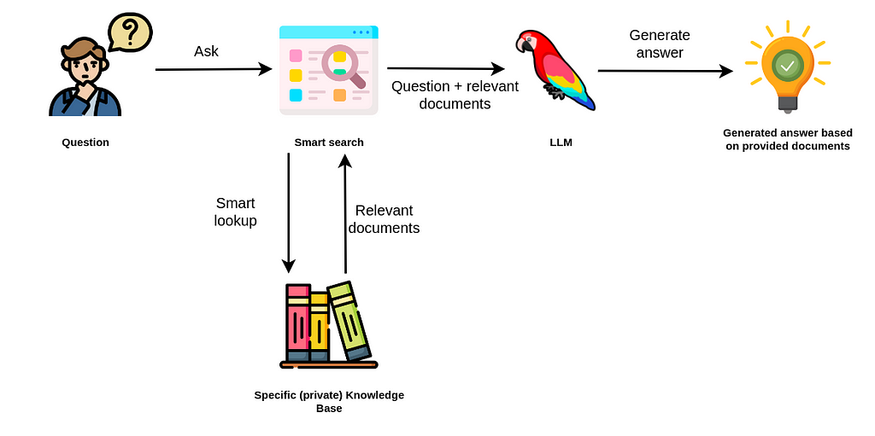
LLMs in Information Retrieval - RAG
question
question +
retrieved documents
User
search engine
question
retrieved documents
Collections of (private) documents
Source

Slide 5
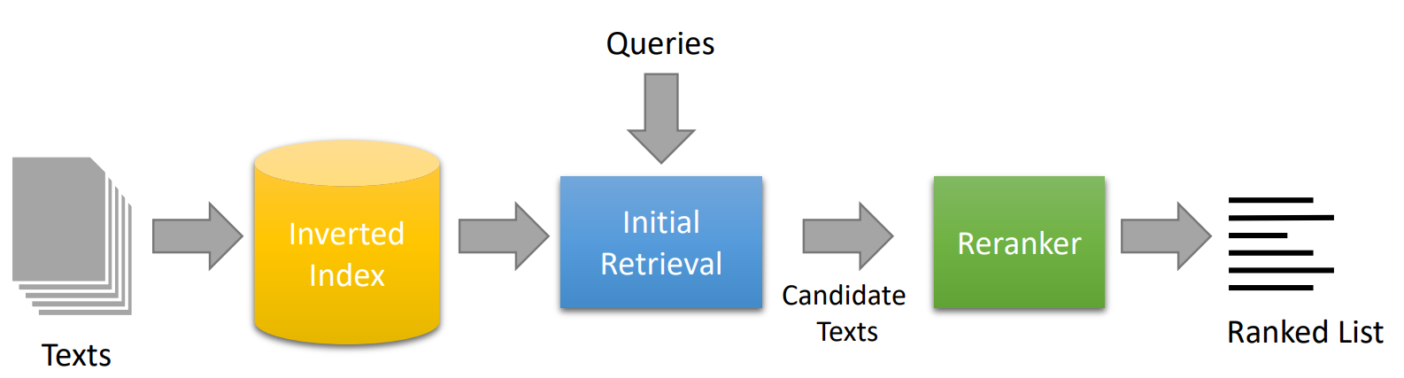
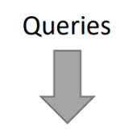
LLMs in Information Retrieval - Search Engines
ANN
Index
Bi-Encoder
Cross Encoder

Slide 6

Processing Long Documents
LLM
1 page (500 words)
1024 dimensional “embedding”
LLM
???
3 pages (1500 words)

Slide 7
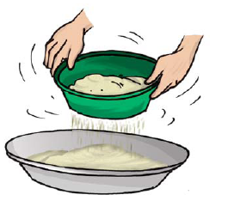
Processing Long Documents
The same encoder will produce a similar size embedding, regardless document size.
As documents get longer, it becomes more difficult to compress their information into a fixed size embedding.

Slide 8
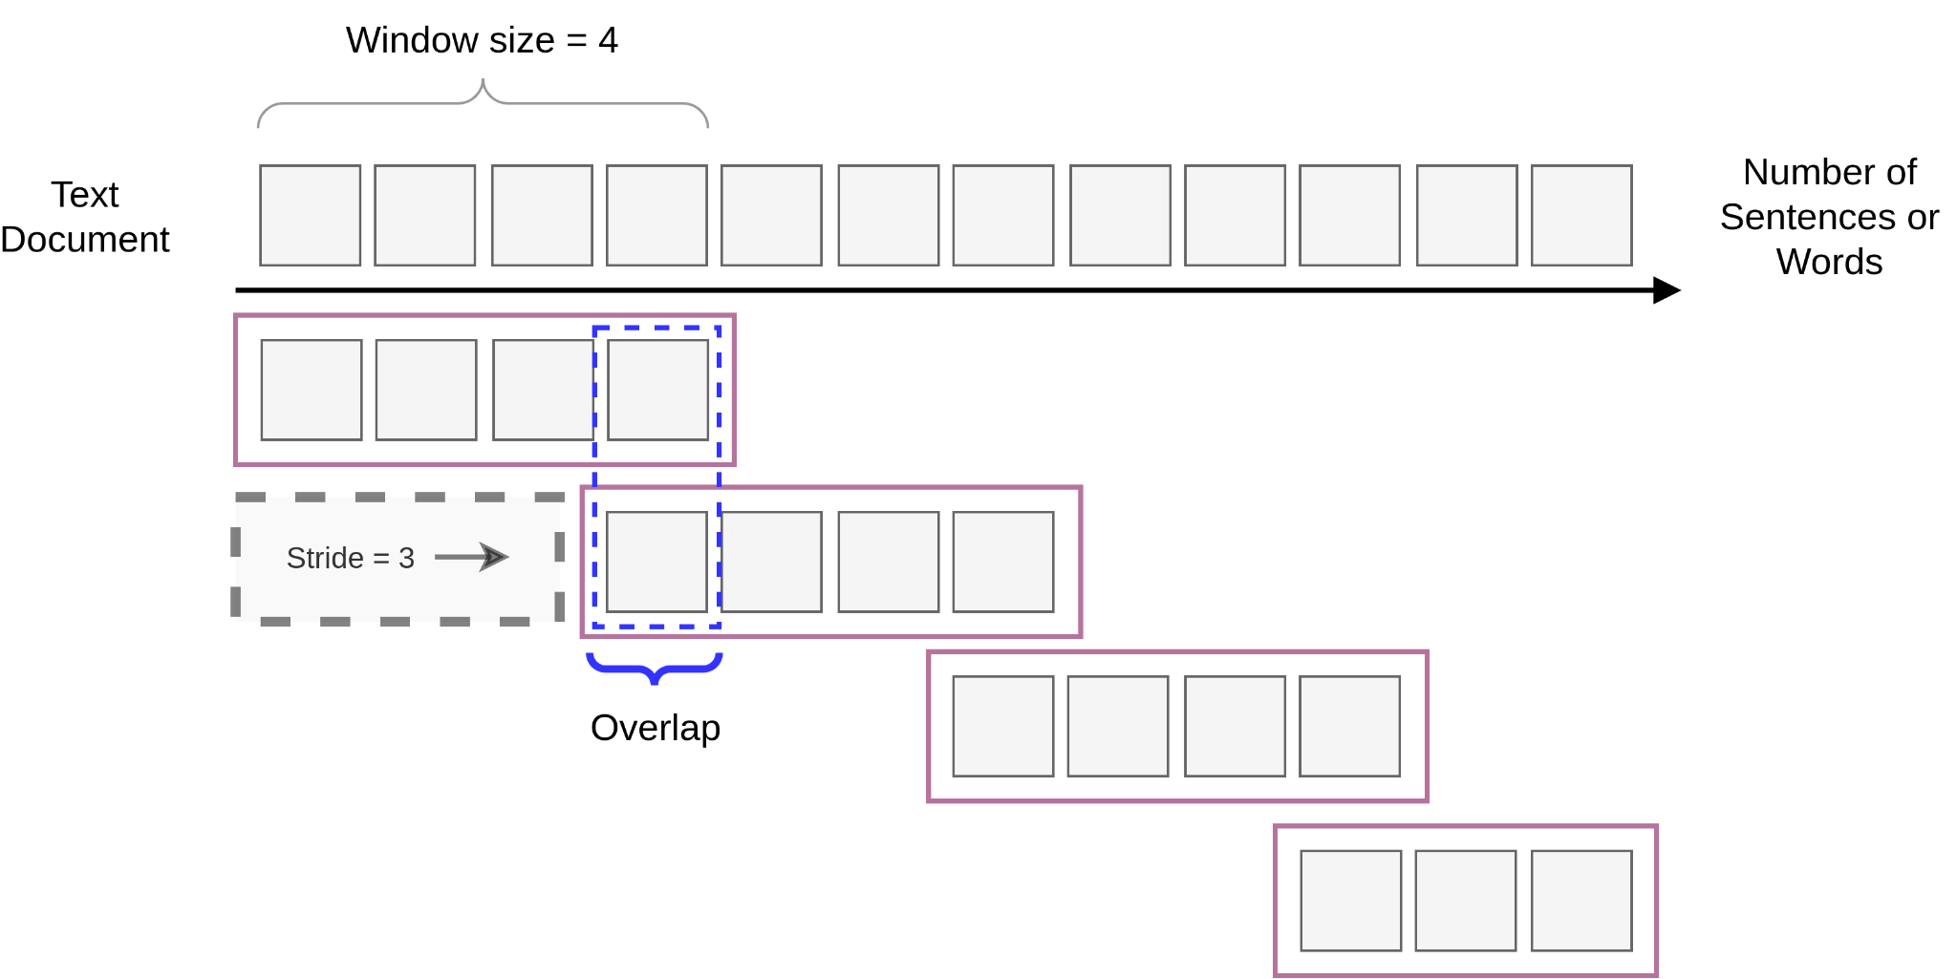
Processing Long Documents - Sliding Window
Encoder
E_{i,w=1}
Encoder
E_{i,w=2}
Encoder
E_{i,w=3}
Encoder
E_{i,w=4}
Smaller strides -> more windows: decreases the chance of separating important information into 2 windows at the expense of having more windows to process.
Related Paper

Slide 9
Tokens and Token Embeddings
What is “halfway” between panda and Croatia?
pandas
Croatia
burritos
Language is inherently discrete, so it’s tough to tell.

Slide 10
Tokens and Token Embeddings – Sparse Embeddings (aka. one-hot)
Word | Index
the | 0
dog | 1
runs | 2
0 | 1 | 0
Language Model
sparse embedding for “dog”
Problem: Space complexity is O(n)

Slide 11
Tokens and Token Embeddings – Pre-trained Word Embeddings
Useful links
word2vec
GloVe
Word | Index
the | 0
dog | 1
runs | 2
I
“The dog runs”
“I walk the dog”
“My dog runs outside often”
dog
the
walk
runs
Idea: Map words to continuous space using co-occurrence

Slide 12
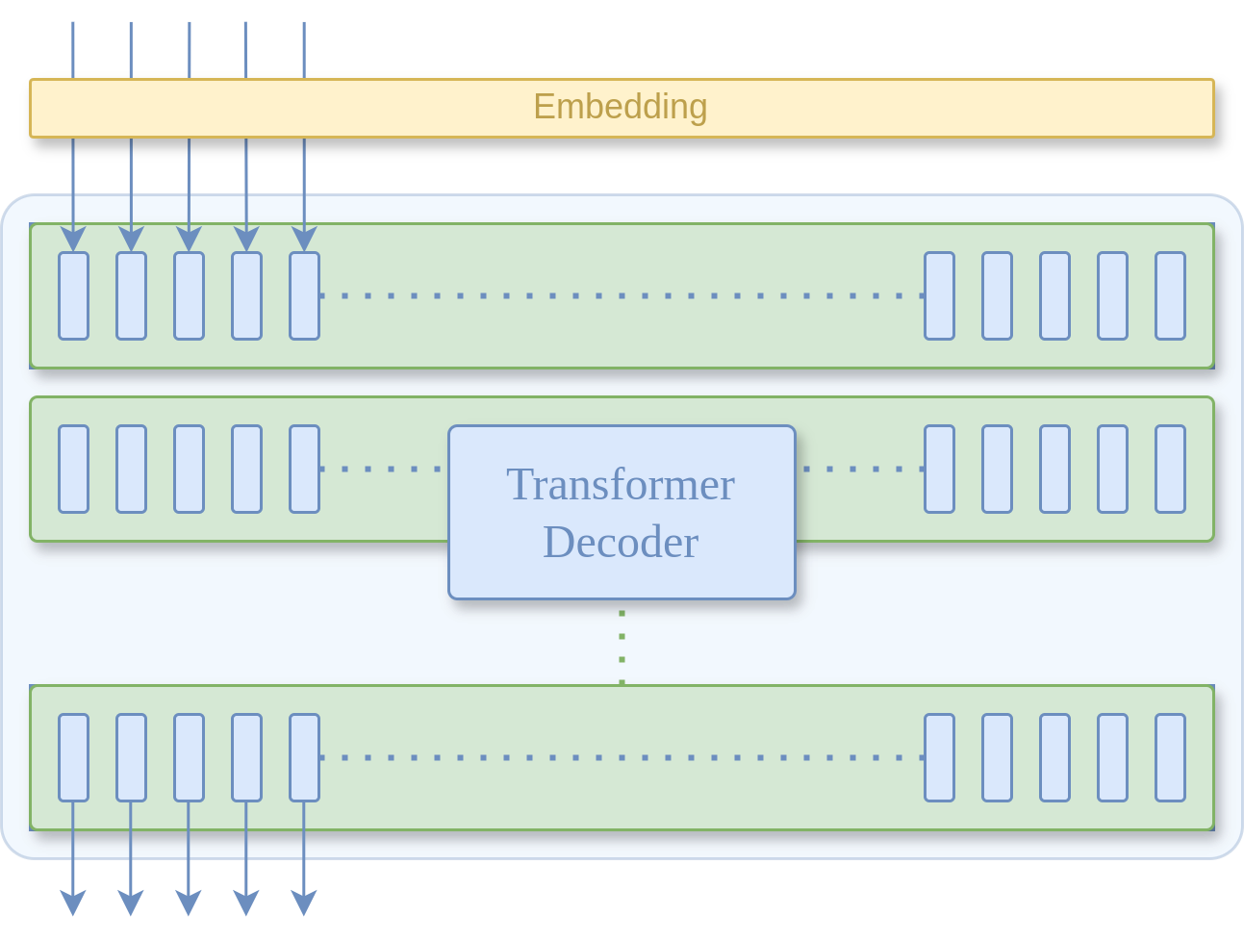
Tokens and Token Embeddings – Jointly Trained with Transformers
The
Word | Index
the | 0
dog | 1
runs | 2
Idea: Add a transformation before the model to turn an index into a continuous vector!
But wait, doesn’t this introduce the growing vocabulary problem again?

Slide 13
Tokens and Token Embeddings – Subword Encoding Techniques
Byte-Pair Encoding Example
Break words into letters (subwords).
Identify most common spans.
Merge the two subwords in the span.
Repeat
Word | Count
the | 6
there | 2
that | 2
t h e </w>
t h e r e </w>
t h a t </w>
Initial subwords
t h e </w> r a
th e </w> r a t
th e</w> </w> r a t
Updated subwords
th e </w> r a t
th e</w> </w> e r a t
th e</w> the </w> r a t
Byte-Pair Encoding
Word Piece Encoding

Slide 14
Decoding Algorithms – Vanilla Sampling
Step 1
candidates
Step 2
candidates
Step 3
candidates
A
A
A
B
B
B
Output:
EBE
<sos>
E
EB
C
C
C
D
D
D
E
E
E
P(y₁ | <sos>)
P(y₂ | E)
P(y₃ | EB)
A
B
C
D
E
A
B
C
D
E
A
B
C
D
E

Slide 15
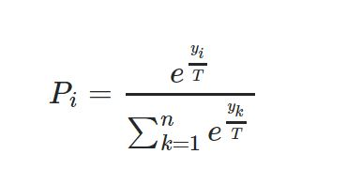
Decoding Algorithms – Temperature
T = temperature (>0)
z^{i} = logit of the i-th token
The lower the temperature, "softmax" becomes closer to "max", that is, more similar to greedy decoding.
The higher the temperature, the more "flattened" the distribution becomes, that is, the more random the predictions become.
T = 0.001
T = 1
T = 10
Target: She likes to travel
A
B
C
D
E
A
B
C
D
E
A
B
C
D
E
Prediction: She likes to travel She likes Paris car fool ##ing

Slide 16
Decoding Algorithms – Top-k Sampling
Idea: sample from only the k tokens with the highest probabilities.
Step 1
Candidates
Step 2
Candidates
Step 3
Candidates
A
A
A
B
B
B
[]
C
CD
C
C
C
D
D
D
E
E
E
P(y₁ | [])
P(y₂ | C)
P(y₃ | CD)
A
B
C
D
E
A
B
C
D
E
A
B
C
D
E

Slide 17
Decoding Algorithms – Top-p Sampling (aka. Nucleus Sampling)
Idea: Only consider tokens within a cumulative probability range p. For example, only look at the most likely tokens summing up to 80%.
Step 1
Candidates
Step 2
Candidates
Step 3
Candidates
A
A
A
B
B
B
[]
C
CD
C
C
C
D
D
D
E
E
E
P(y₁ | [])
P(y₂ | C)
P(y₃ | CD)
A
B
C
D
E
A
B
C
D
E
A
B
C
D
E

Slide 18
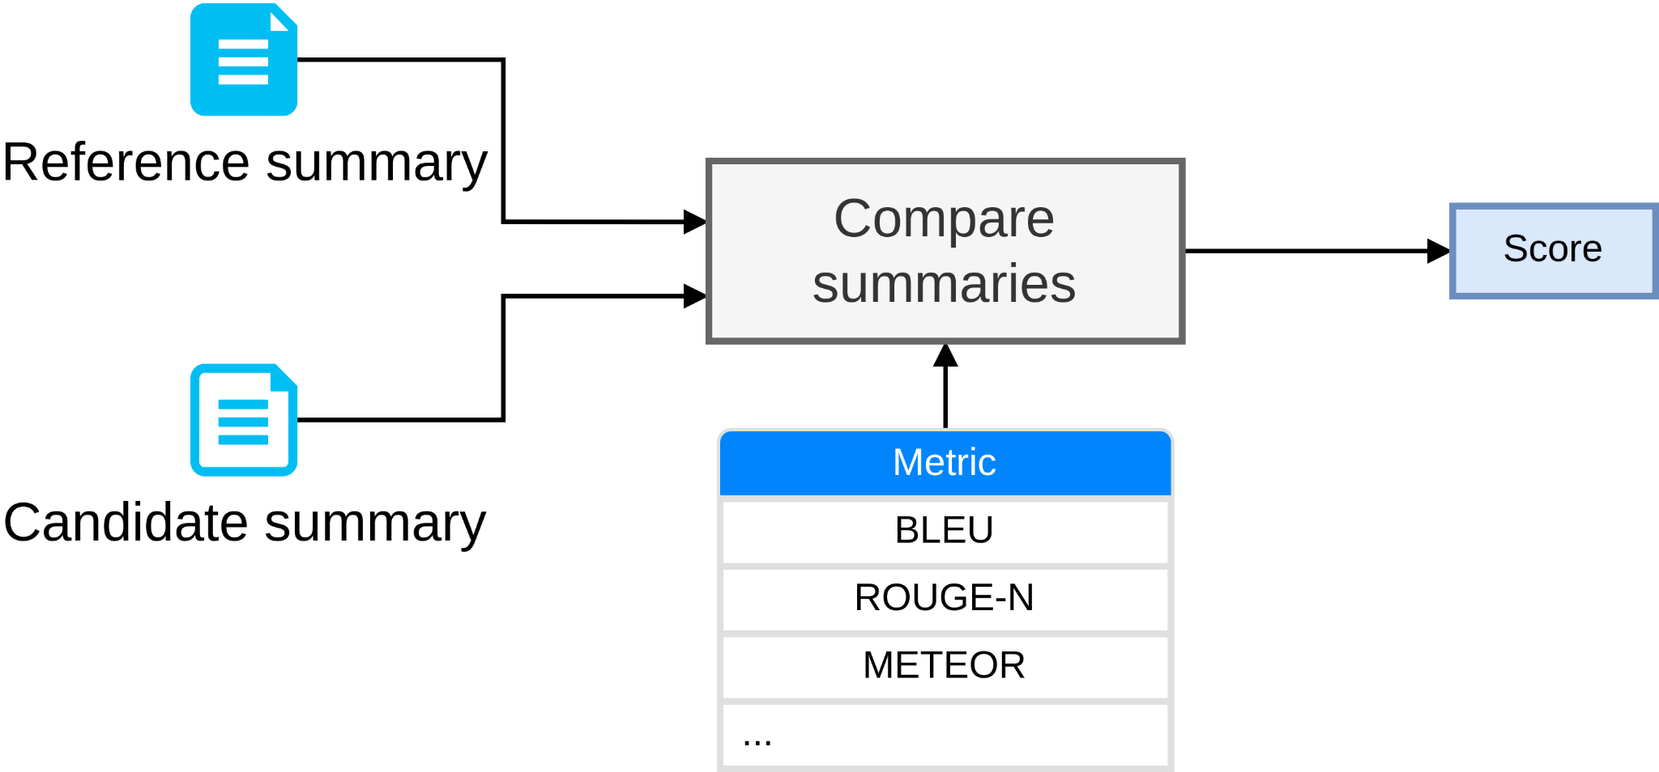
Evaluating Generative Language Models – “Old” Pipeline

Slide 19
Evaluating Generative Language Models – BLEU Score
BLEU (bilingual evaluation understudy) is a metric to evaluate the quality of machine-generated text by comparing them to a set of references.
Modified version of Precision
P = m / w
m: number of words in common among candidate and ground-truth texts
w: number of words in the candidate text
Doesn’t account for meaning or context
Penalizes texts that don’t match target reference
[Video]

Slide 20
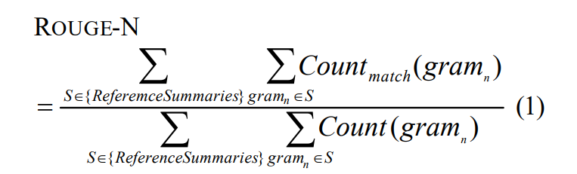
Evaluating Generative Language Models – ROUGE Score
ROUGE metrics are recall-oriented, meaning they focus on the ability of the summary to include important information from the reference summaries.
Some variants: ROUGE-1, ROUGE-2, and ROUGE-L.
ROUGE-1 and ROUGE-2 are based on comparing unigrams and bigrams, respectively, between the output summary and reference summaries.
[Video]

Slide 21
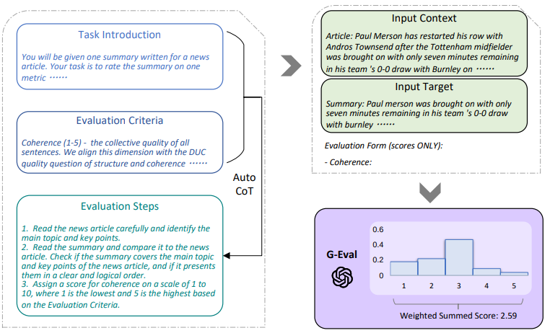
Evaluating Generative Language Models – G-Eval

Slide 22
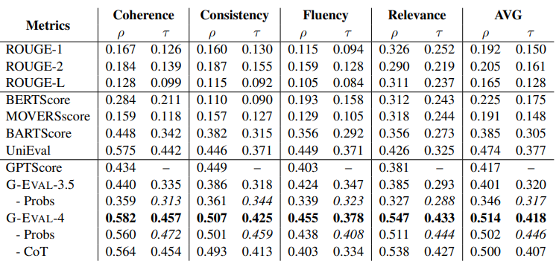
Evaluating Generative Language Models – G-Eval

Slide 23
Evaluating Generative Language Models – G-Eval
Notebook Demo – G-Eval

Slide 24
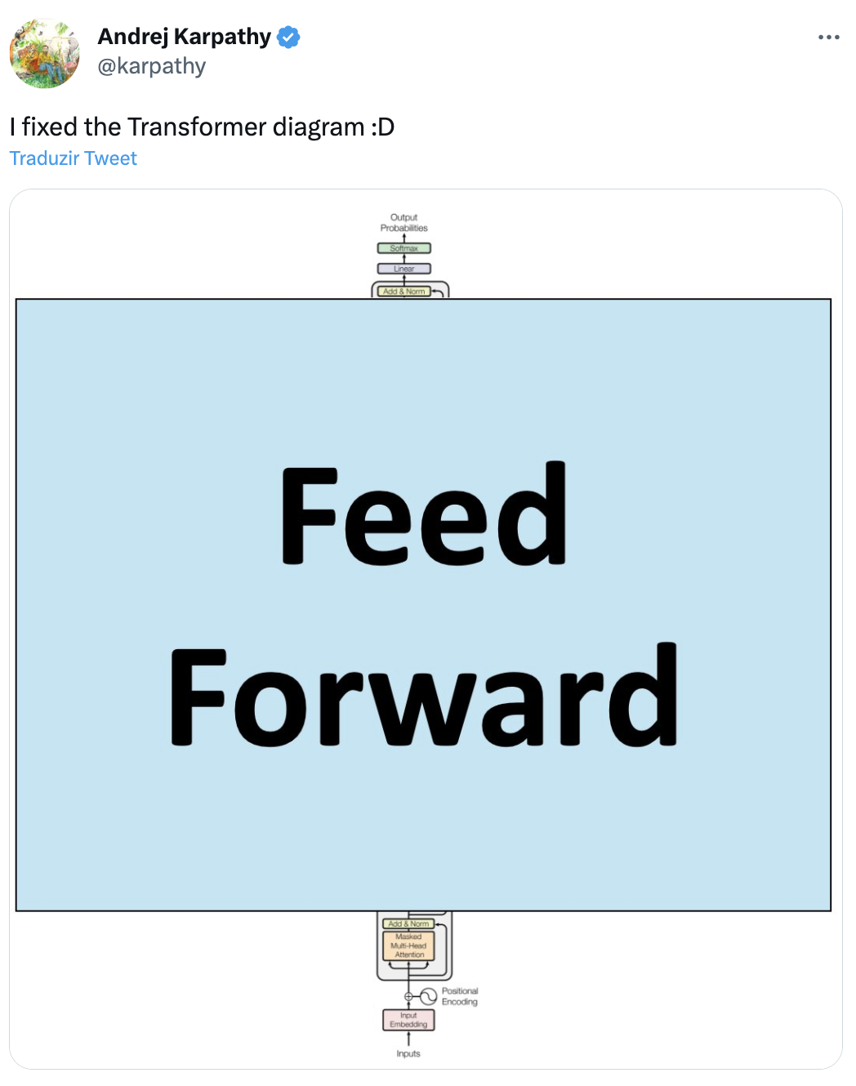
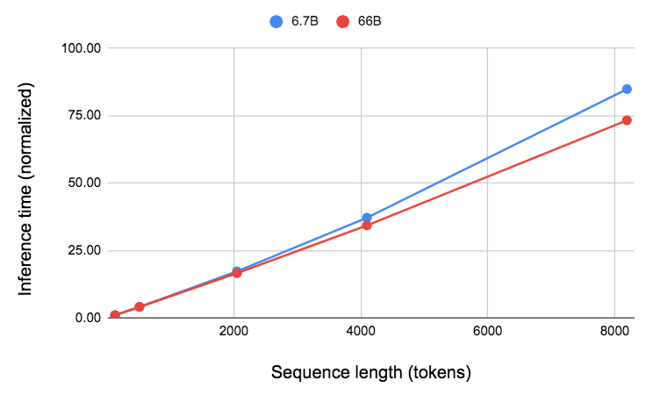
Computational Overhead of LLMs
Most FLOPs are spent in the linear projections → linear increase in inference time wrt sequence length
Source
Source

Slide 25
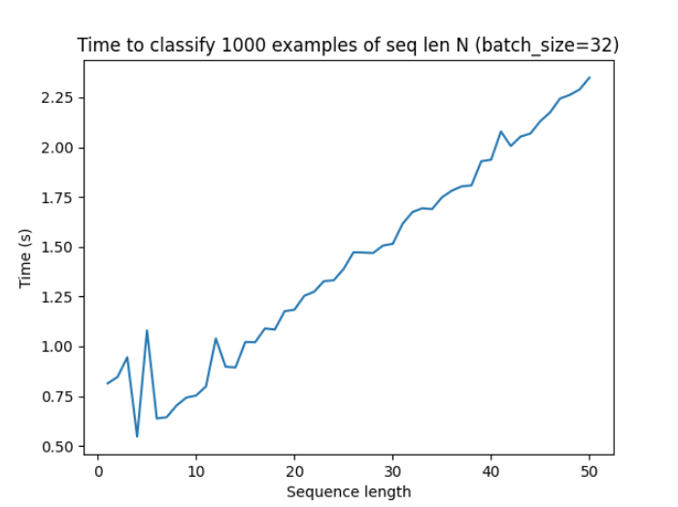
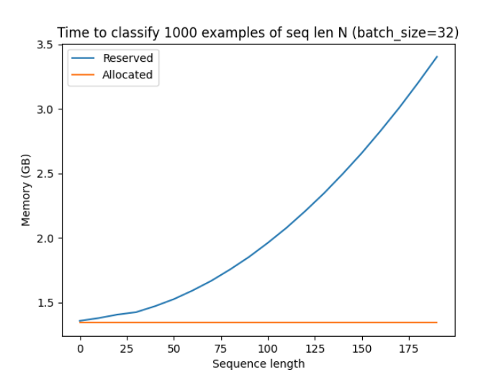
Computational Overhead of LLMs
BERT-Large (330M parameters)

Slide 26
Computational Overhead of LLMs
Writing takes longer than reading:
1 sec to encode 1,000 input tokens
1 sec to generate 4 tokens
For instance:
Classify a one-page document (990 input tokens + 10 output tokens): 1 + 5 secs
Write an one-page essay (20 input tokens + 980 output tokens): 0.2 + 245 secs
Takeaway: Cast tasks into classification tasks rather generative tasks when possible
[Learn more about why decoding is slower than encoding]

Slide 27
LLMs Going Forward
LLMs with more parameters
generally perform better than lower parameter counterparts
cost more wrt electricity and hardware
GPT-4 estimated training costs were around USD 100m. SOTA performance requires deep pockets and these models are becoming less accessible as a result.

Slide 28
End of Module 4
Questions?

